Slide 1


Tracer & Colorer
Bulldozer
Transport

Slide 2


Tracer & Colorer
Grue
Transport

Slide 3


Tracer & Colorer
Fusée
Transport

Slide 4
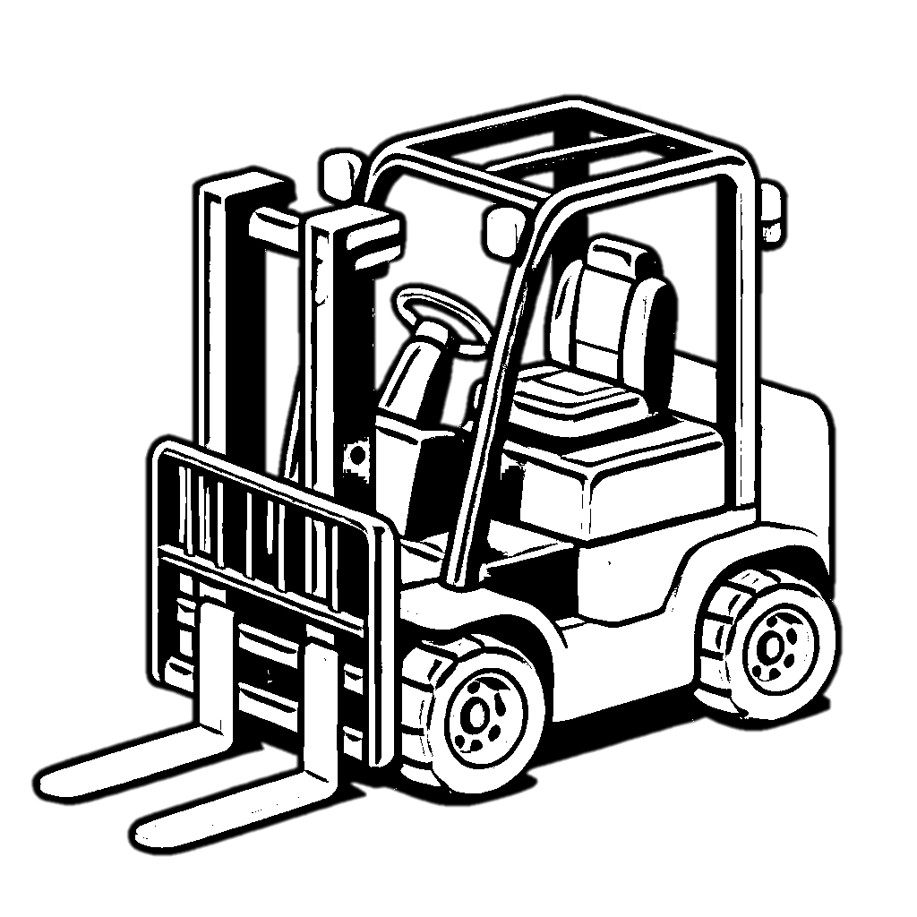

Tracer & Colorer
Transport
Chariot élévateur

Slide 5


Tracer & Colorer
Transport
Excavatrice

Slide 6


Tracer & Colorer
Tracteur
Transport

Slide 7


Tracer & Colorer
Transport
Ambulance

Slide 8


Tracer & Colorer
Navire
Transport

Slide 9


Tracer & Colorer
Transport
Bateau

Slide 10


Tracer & Colorer
Transport
Moto

Slide 11


Tracer & Colorer
Transport
Dirigeable

Slide 12


Tracer & Colorer
Transport
Carrosse

Slide 13


Tracer & Colorer
Transport
Traîneau

Slide 14


Tracer & Colorer
Transport
Téléphérique

Slide 15


Tracer & Colorer
Transport
Jet-ski

Slide 16


Tracer & Colorer
Transport
Camionnette

